Slide 1



Booster-SHOT: Boosting Stacked Homography Transformations for Multiview Pedestrian Detection with Attention
Jinwoo Hwang*✝, Philipp Benz✝, Pete Kim✝
*Seoul National University
✝DeepingSource

Slide 2
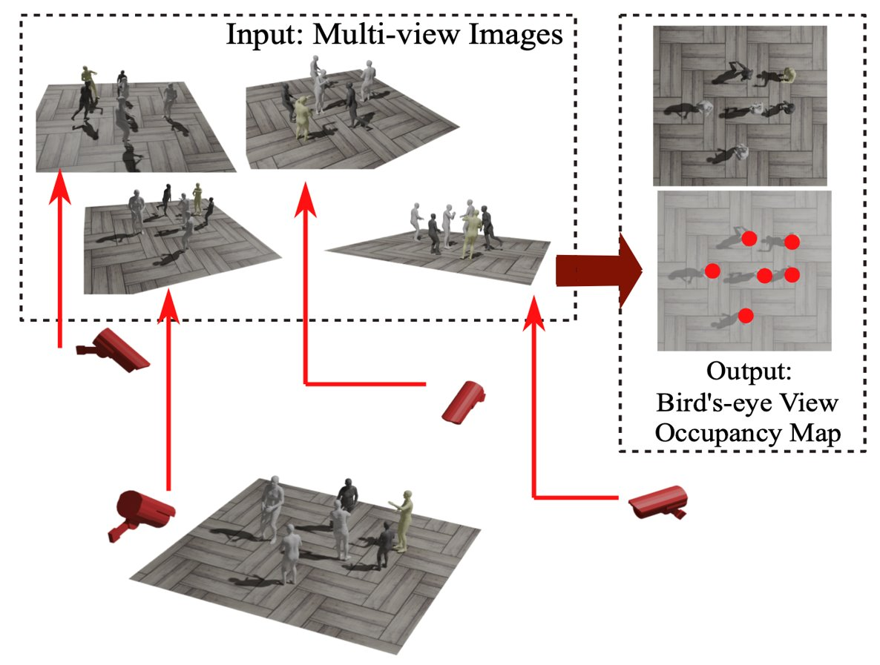
Multiview pedestrian detection
Using multiple cameras to detect pedestrians
overlapping camera views normally used
cameras have fixed world coordinates
multiview aggregation collects information across views

Slide 3
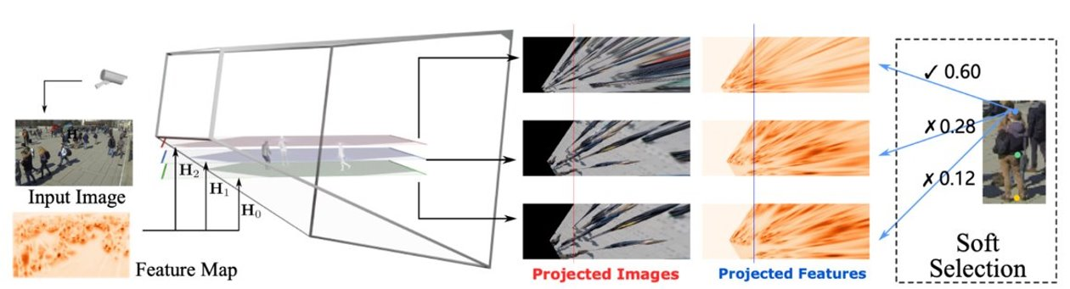
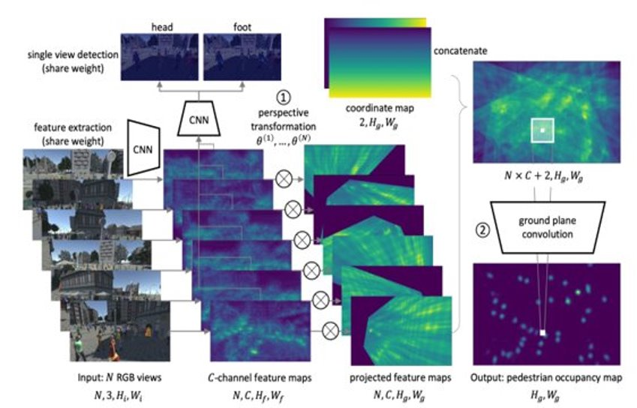
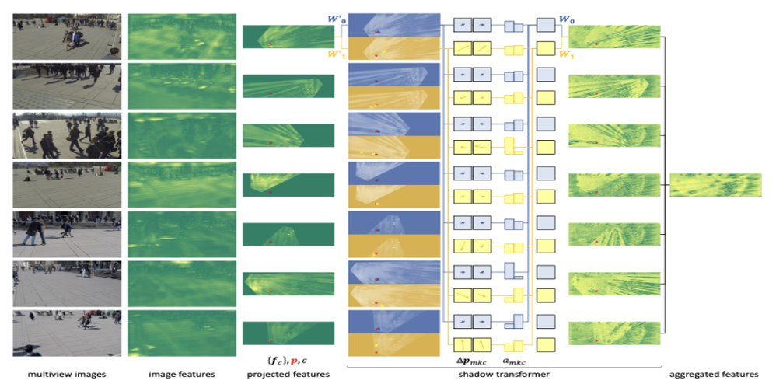
Previous methods
Stacked Homography Transformations for Multi-View Pedestrian Detection (SHOT^{[2]})​
Multiview detection with feature perspective transformation. (MVDet^{[1]})​
Multiview detection with shadow transformer (MVDeTr^{[3]})​
[1] Hou, Y., Zheng, L., & Gould, S. Multiview detection with feature perspective transformation. In ECCV 2020​
[2] Hou, Y.; and Zheng, L. Multiview detection with shadow transformer (and view-coherent data augmentation). In ACMM 2021​
[3] Song, L., Wu, J., Yang, M., Zhang, Q., Li, Y., & Yuan, J. Stacked Homography Transformations for Multi-View Pedestrian Detection. ICCV​
Notes:
MVDet
input images from different viewpoints are passed through a feature extractor
additional CNN that detects head and feet of pedestrians
projected to the ground plane via homography transformation and concatenated
apply CoordConv technique (x, y coordinate map concat)
pass through CNN to obtain final BEV heatmap
SHOT
introduces additional planes parallel to the ground plane with different distances to the ground
soft selection module where a network learns which homography should be used for which pixel
MVDeTr
proposed the use of affine transformation (view-coherent) augmentations
applied deformable transformer to latter part of network
“shadow transformer” as it handles various distortion patterns

Slide 4
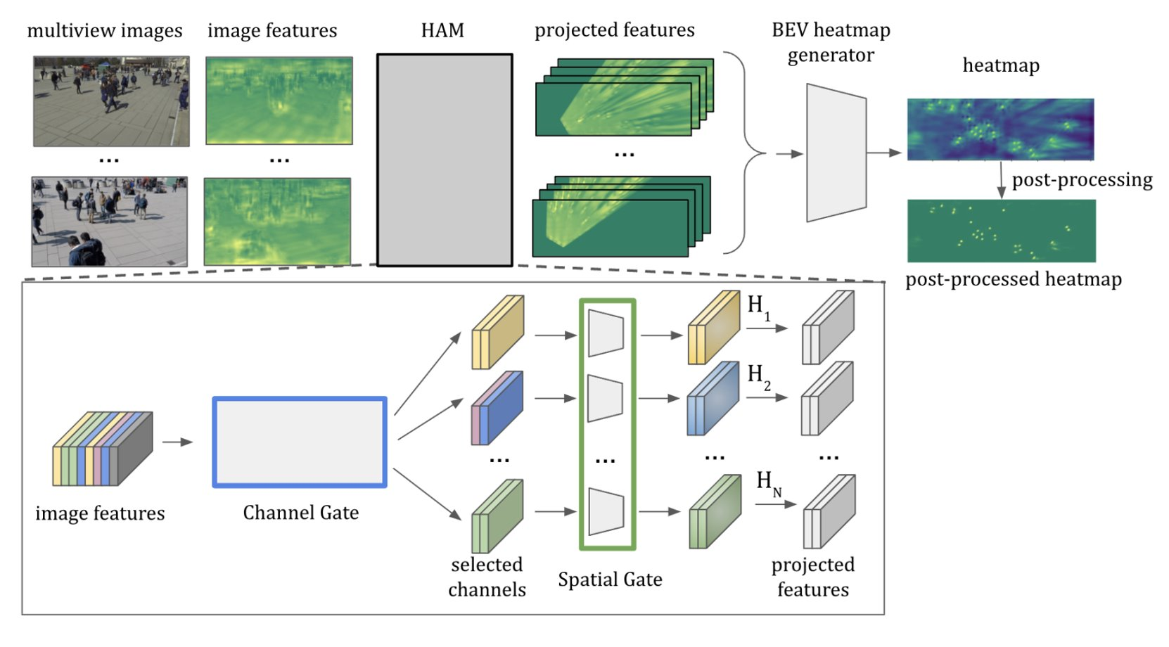
Overview of our approach
Notes:
SHOT soft selection module
softmax activation → each pixel projected to some extent to each homography
even the homography given the lowest score affects the projected outcome
introduces some noise into the final projected feature map
all feature channels corresponding to a single pixel multiplied by the same value when projected

Slide 5
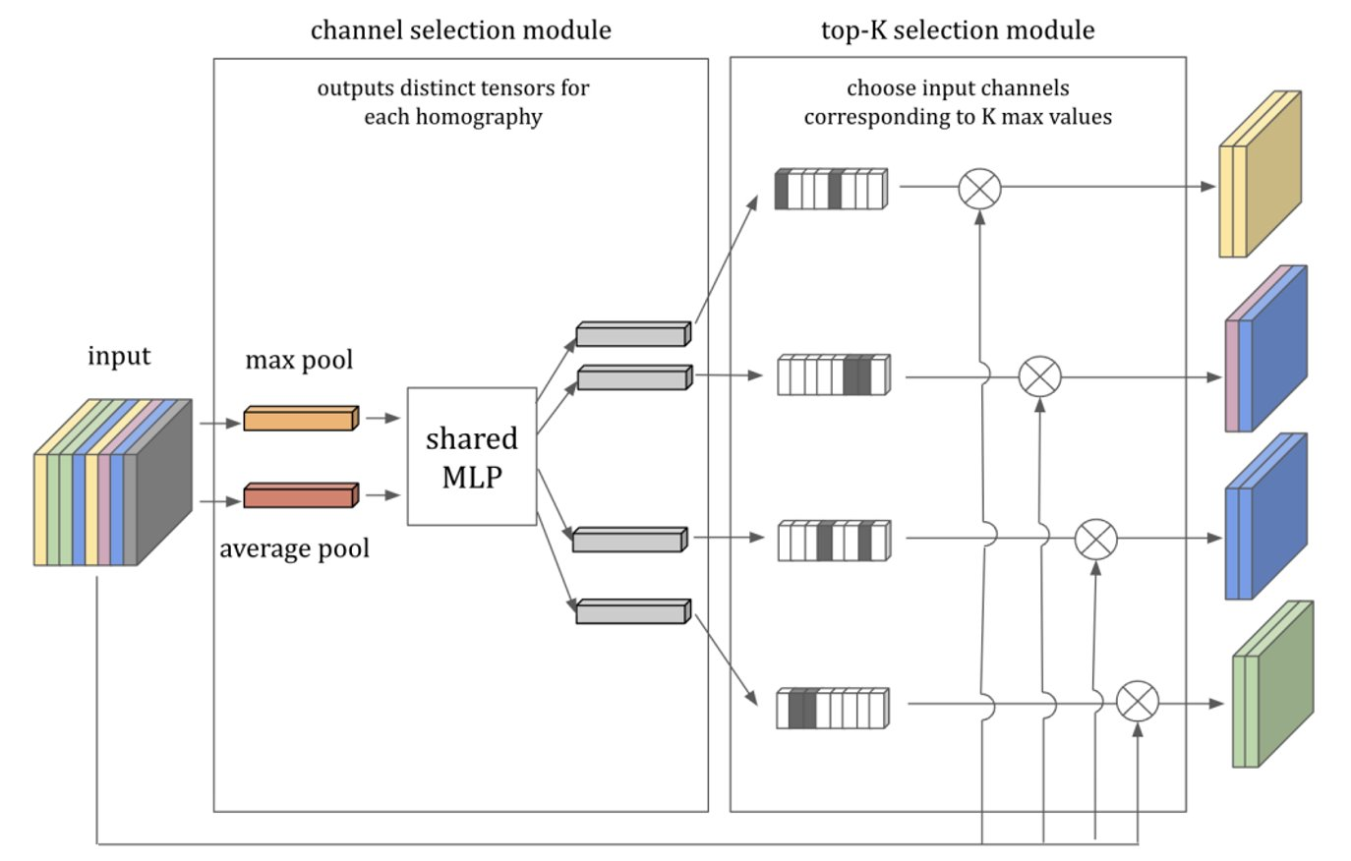
Channel Gate
Depending on the homography, different channels are of importance.​

Slide 6
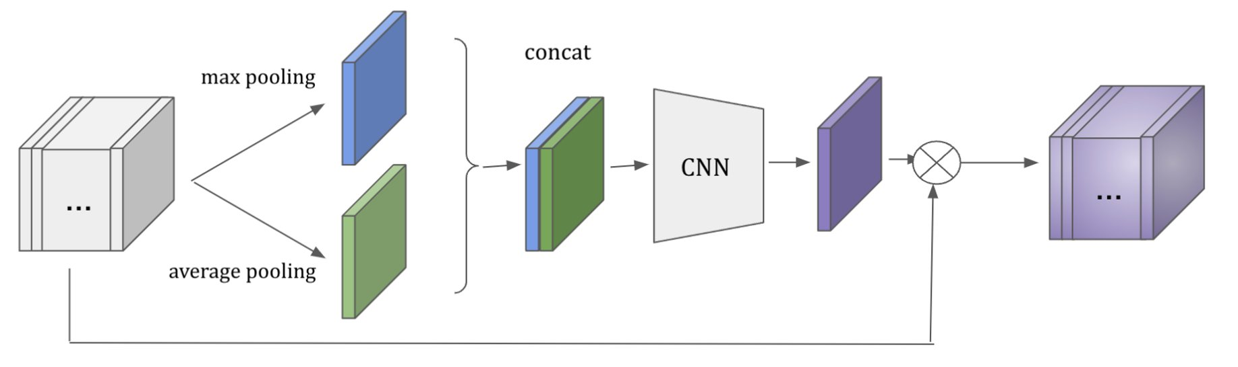
Spatial Gate
For each view and homography combination, different spatial features are of different importance​

Slide 7
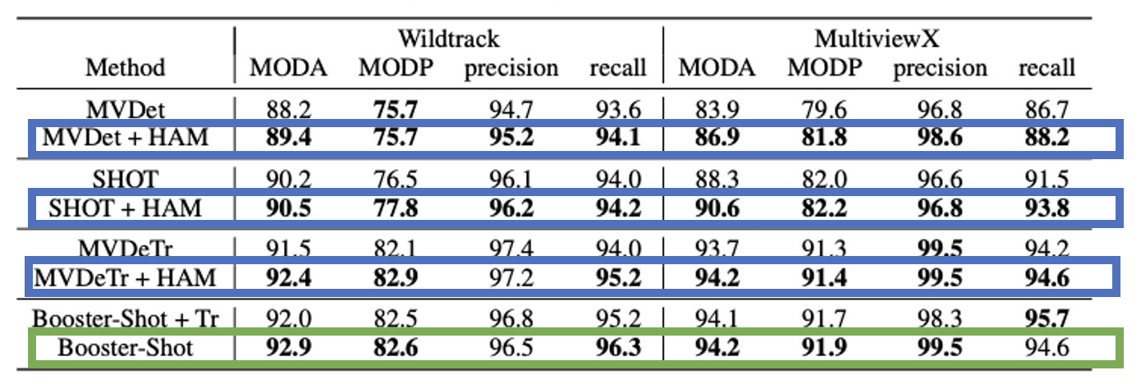
Performance comparison
Plugging in HAM improves the performance of existing methods​
Booster-SHOT outperforms previous methods​

Slide 8
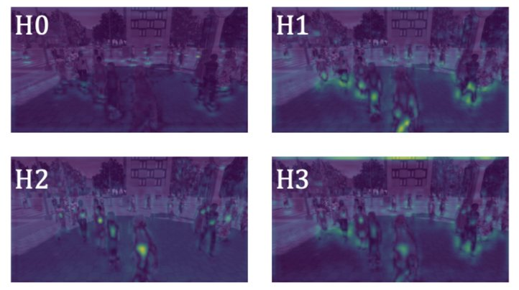
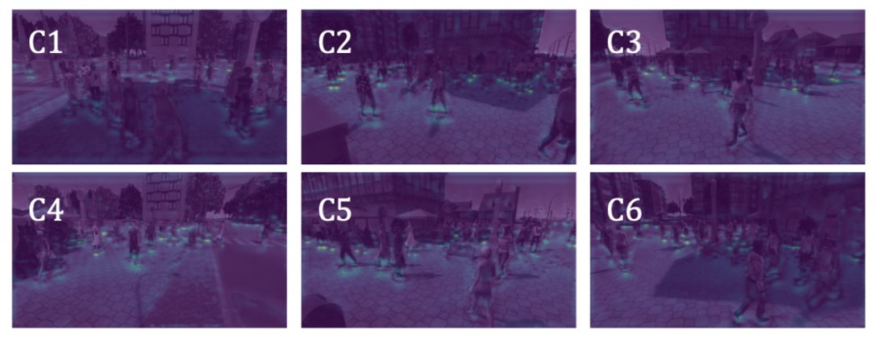
Homography-wise output from channel selection​
Camera view-wise output from the channel selection module​

Slide 9
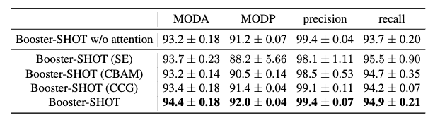
HAM vs existing attention mechanisms
SE, CBAM, CCG show slight improvement over “no attention” case
HAM shows significant improvement over SE, CBAM, CCG

Slide 10
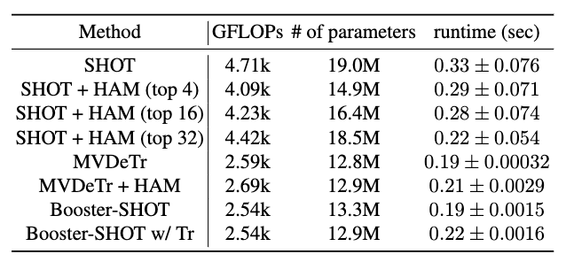
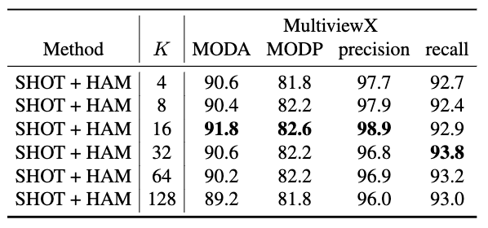
Further ablations
computational complexity & performance tradeoff

Slide 11
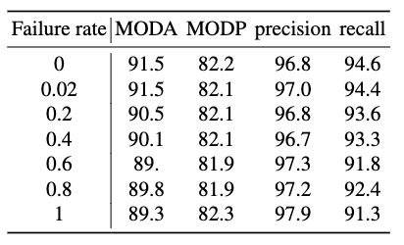
Performance under spontaneous camera failure
Simulated real-world scenario with camera failure
failure rate: ratio of frames for which at least 1 camera fails
camera failure: replace image with all-black (RGB 0,0,0)

Slide 12
Thank you for listening!
poster session: Day 1
contact info: luorix@snu.ac.kr

